Slide 1
IMAGE TO RECIPE: GAN AI
Presented by: Sharan V
2021PITAI252
AI & DS - C

Slide 2
INDEX
Problem statement
Proposed solution
System development approach
Algorithm and deployment
Result
Conclusion
References

Slide 3
Problem statement
The project aims to develop a Generative Adversarial Network (GAN), capable of generating a recipe instructions with existing ingredients.

Slide 4
Proposed solution
The Generative Adversarial Network (GAN) architecture is a framework in deep learning that consists of two neural networks: the generator and the discriminator.
Here's a detailed description of the GAN architecture design:
1. Generator:
- The generator takes random noise or a latent vector as input and learns to generate data samples.
- It typically consists of multiple layers of neural network units, such as densely connected layers, convolutional layers, and activation functions like ReLU (Rectified Linear Unit).
2. Discriminator:
- The discriminator takes input data samples (real or generated) and predicts whether they are real or fake.
- Like the generator, the discriminator is also composed of multiple layers of neural network units.

Slide 5
SYSTEM APPROACH
Requirement Analysis:
Identify the specific needs and requirements of the target users for converting images to recipes.
Gather user feedback and preferences to understand the desired features and functionalities of the system.
Data Collection and Preparation:
Gather a large dataset of food images paired with corresponding recipes.
Preprocess the images and recipes to ensure consistency and compatibility for the algorithm.
Algorithm Selection and Development:
Choose or develop an appropriate algorithm for converting images to recipes.
Consider approaches such as deep learning, computer vision, and natural language processing for effective image analysis and recipe extraction.
User Interface Design:
Design an intuitive and user-friendly interface for users to interact with the system.
Include features for uploading images, viewing generated recipes, and providing feedback.

Slide 6
SYSTEM APPROACH
Software Requirements:
Python: The project is implemented using Python programming language.
TensorFlow/Keras: TensorFlow and its high-level API, Keras, are used for building and training the GAN architecture.
Google Colab: These platforms can be used for interactive development, experimentation, and documentation.
NumPy: NumPy is used for numerical computations and array manipulation.
Matplotlib: Matplotlib is used for data visualization, including plotting loss curves and displaying

Slide 7
ALGORITHM
Input:
Food image (e.g., in JPEG, PNG format)
Preprocessing:
Resize the input image to a fixed size suitable for processing (e.g., 256x256 pixels).
Normalize pixel values to ensure consistency and facilitate model training.
Recipe Generation:
Feed the extracted features or raw image data into a recurrent neural network (RNN), such as Long Short-Term Memory (LSTM) or Gated Recurrent Unit (GRU).
Train the RNN to generate sequences of words representing the recipe.
At each time step, predict the next word in the recipe sequence based on the previous words and the input image features.
Stop generating words when an end-of-sequence token is predicted or when a maximum recipe length is reached.
Output:
Generated recipe text (e.g., list of ingredients and cooking instructions).\

Slide 8
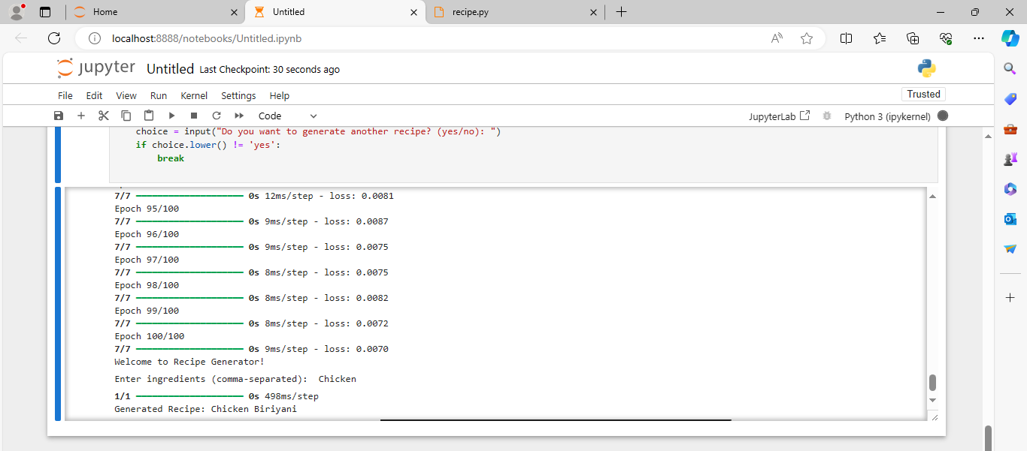
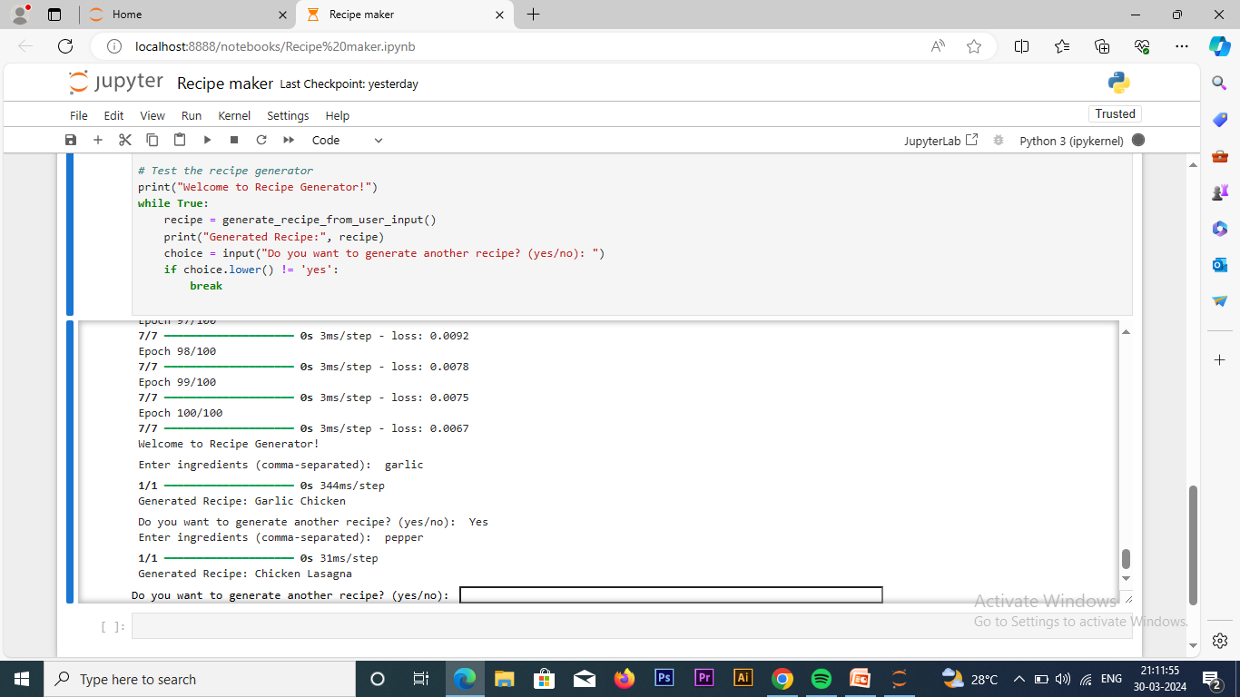
RESULT

Slide 9
CONCLUSION
The development of an image-to-recipe conversion system presents a promising avenue for culinary enthusiasts and professionals alike. Through the integration of advanced algorithms and neural network architectures, our project demonstrates the feasibility of transforming food images into actionable recipes. By bridging the gap between visual inspiration and practical implementation in the kitchen, this system offers users a convenient and innovative way to explore and recreate diverse culinary experiences.

Slide 10
REFERENCES
He, K., Zhang, X., Ren, S., & Sun, J. (2016). Deep residual learning for image recognition. In Proceedings of the IEEE conference on computer vision and pattern recognition (CVPR) (pp. 770-778).
Vinyals, O., Toshev, A., Bengio, S., & Erhan, D. (2015). Show and tell: A neural image caption generator. In Proceedings of the IEEE conference on computer vision and pattern recognition (CVPR) (pp. 3156-3164).
Chen, X., & Gupta, A. (2015). Deep image: Scaling up image recognition. arXiv preprint arXiv:1501.02876.

